Slide 1
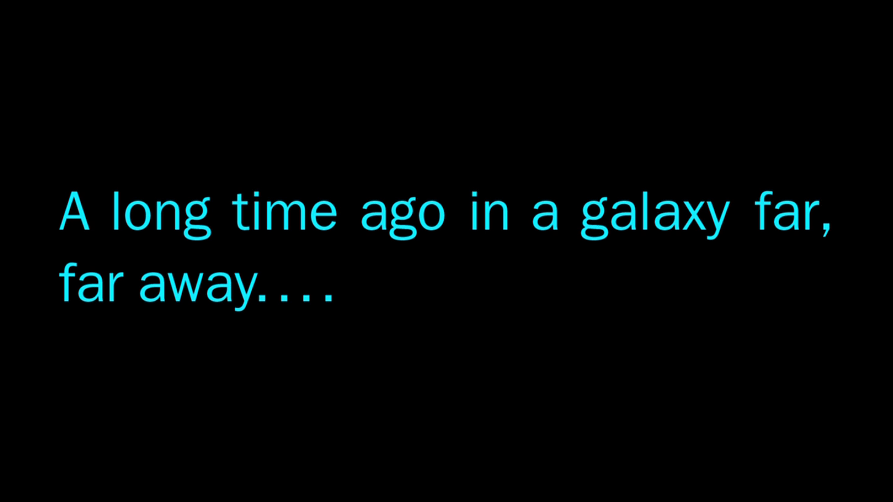


Slide 2

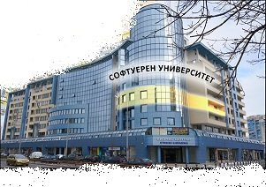
Java Basics Teamwork
Space Siths

Slide 3
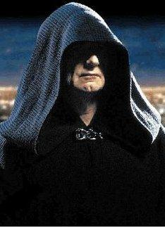
THE DARK LOARD OF THE SITHS

Slide 4

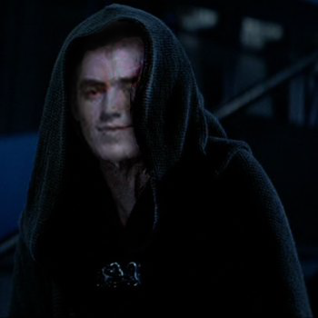
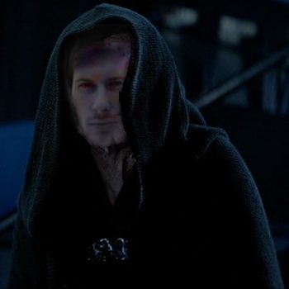
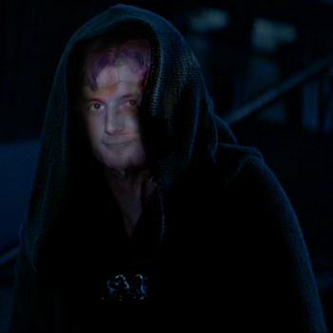
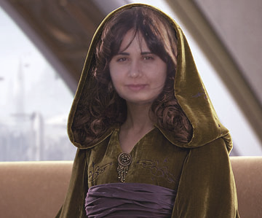
TEAM “ZIOST”
Lord Niyker
Lord Ilwia
Lord Venra
Princess Paemi

Slide 5
USED TECHOLOGIES
Java
JFrame
Elcipse IDE
Git

Slide 6
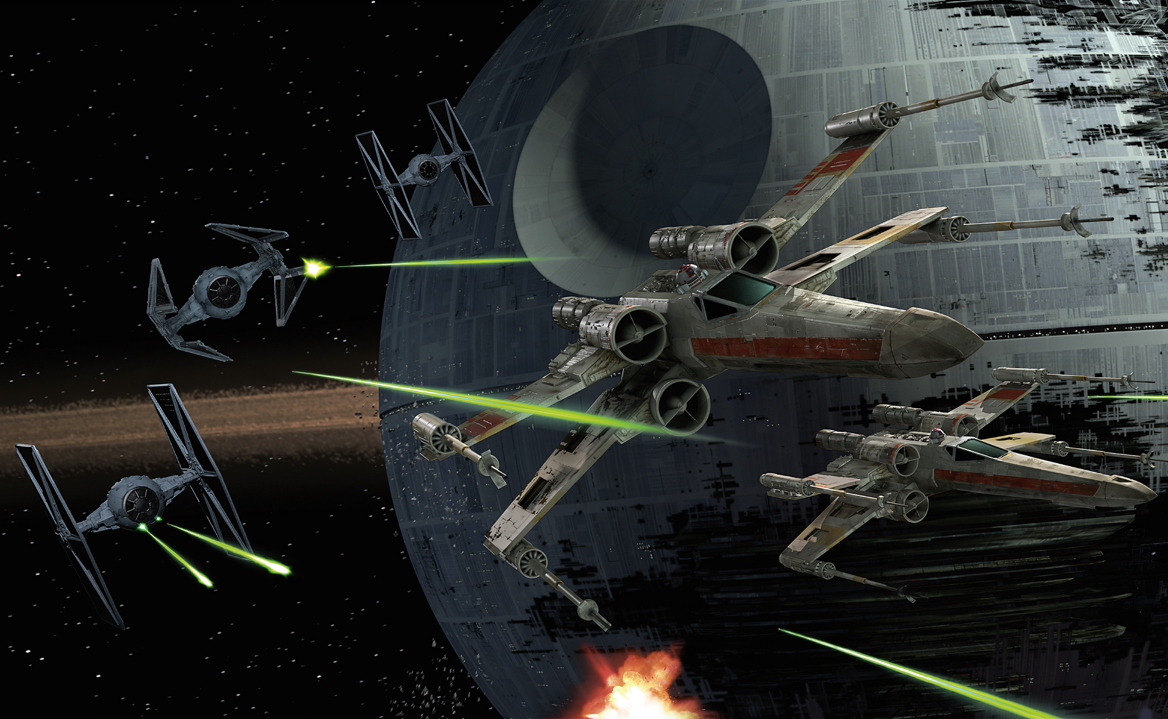
THE EXPECTATIONS

Slide 7
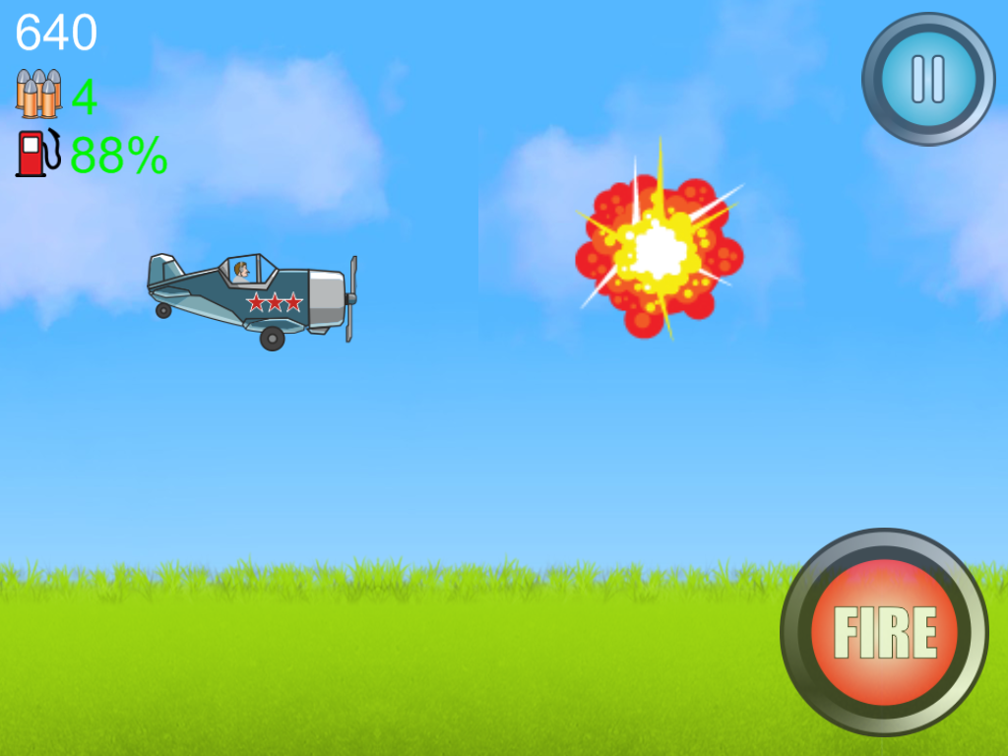
THE REALITY

Slide 8
LIVE DEMO

Slide 9
KEEP CODING

